Slide 1

CMPE 313 Project Presentation
Ayfer Feyza Şahin 30932496534 Zeynep Ayca Tanışlı 33326013720 Müge Nur Özcan 29588536466 Zülal Karın 12622989076

Slide 2

Information About the Project

Slide 3
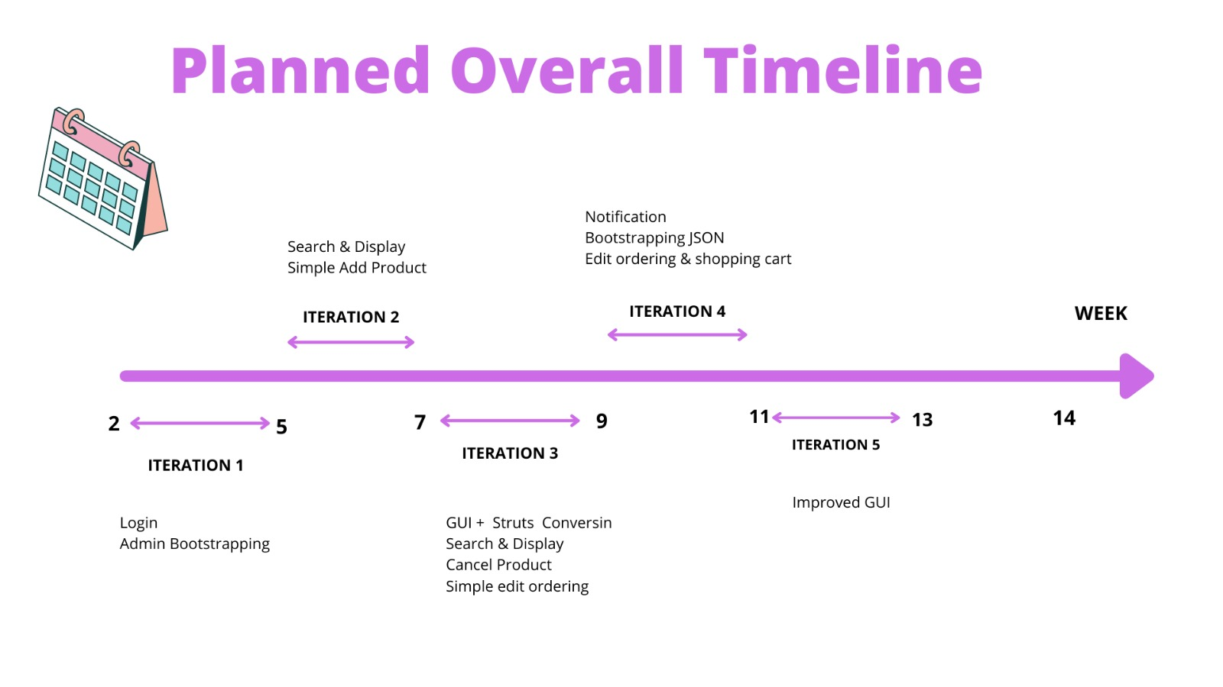

Slide 4



Used Technologies
Visual Studio Code was used to develop our web application.
We used the JSON format to describe the structure of the data.
Java language was used for the back-end application.
Java was used for dynamic instantiation of objects.

Slide 5
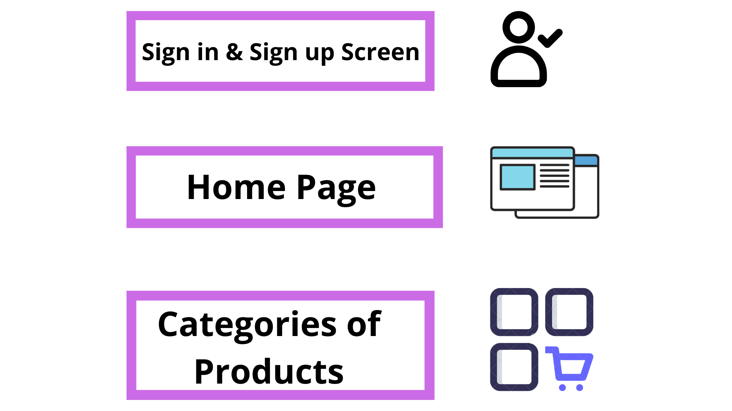
High Level Architecture

Slide 6

Sign in & Sign up Screen

Slide 7
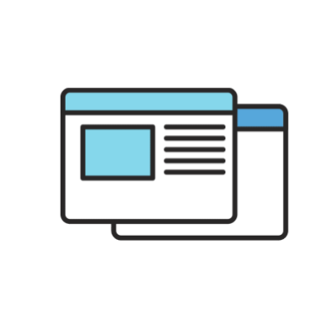
Home Page

Slide 8
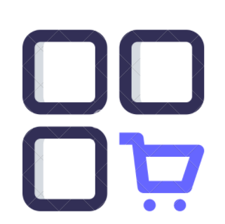
Categories of Products

Slide 9
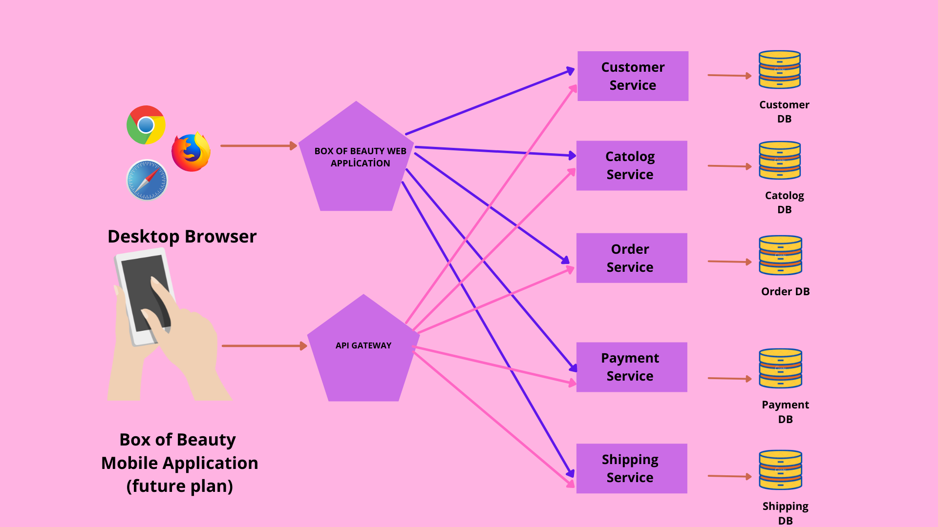
Microservice Architecture of Box of Beauty

Slide 10
Customer Service Interface Example
import java.util.HashMap;
import org.springframework.stereotype.Service;
import com.Spring.ShopApp.model.User;
@Service
public interface CustomerService {
Customer findByMobile(String mobile) throws Exception;
Customer getUserDetailById(long customerId) throws Exception;
Customer signUpCustomer(HashMap<String,String> signupRequest) throws Exception;
// if there is an e-mail or mobile phone before, we need to send an error
// I will create an unimplemented method in the customerServiceImp class.
}

Slide 11
public class CustomerServiceImpl implements CustomerService {
CustomerRepository ur;
public CustomerfindByMobile(String mobile) throws Exception {
return ur.findByMobile(mobile).orElseThrow(() -> new Exception("Customer not found!")); }
public Customer getCustomerDetailById(long customerId) throws Exception {
return ur.findById(customerId).orElseThrow(() -> new Exception("Customer not found!")); }
public Customer signUpCustomer(HashMap<String, String> signupRequest) throws Exception {
try { if (ur.findByMobile(signupRequest.get("mobile")).isPresent()) {
throw new Exception("This number has already been logged in."); }
Customer user = new Customer();
customer.setName(signupRequest.get("name"));
customer.setEmail(signupRequest.get("email"));
customer.setMobile(signupRequest.get("mobile"));
customer.setPassword(signupRequest.get("password"));
ur.save(customer);
return customer; }
catch (Exception e) {
throw new Exception(e.getMessage());
} } }
Customer Service Implementation Example

Slide 12
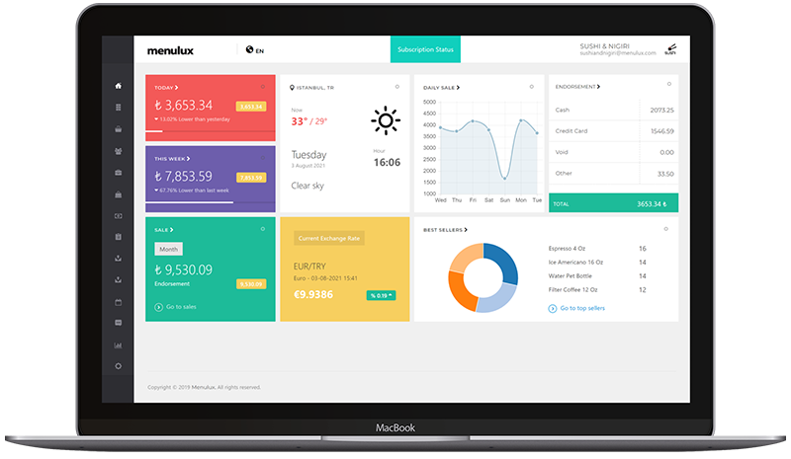
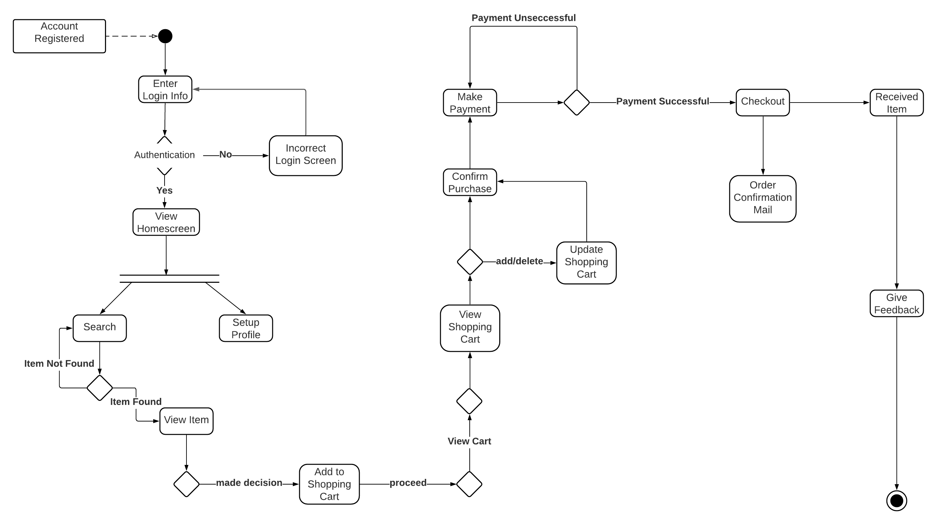
System Menu

Slide 13
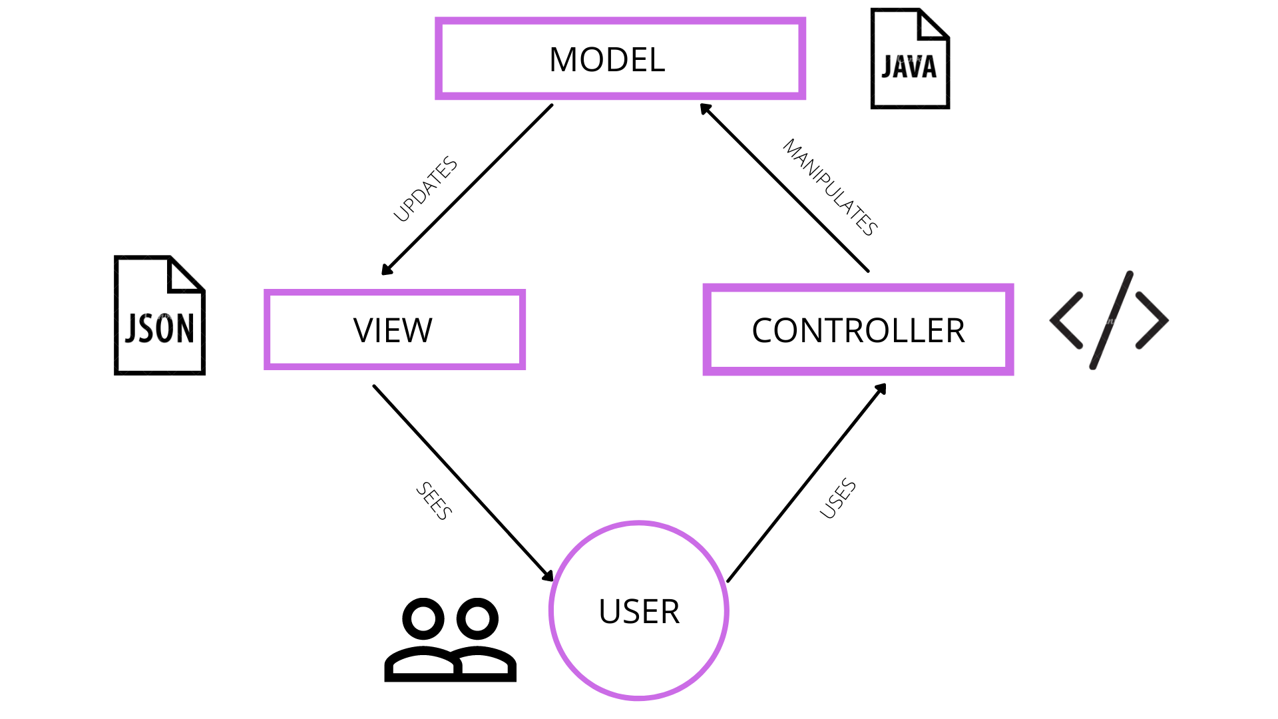
Low Level Architecture
We decided to use the MVC (Model-View-Controller) architectural pattern for low-level design.
The project's files mirror the MVC pattern itself.
Model – Java files
View – JSON
Controller – Activities

Slide 14
Packages, Classes, and Functionality
Repository
CustomerRepository.java
ProductRepository.java
CheckoutCartRepository.java
CategoryRepository.java
AddtoCartRepository.java
Controller
AddtoCartController.java
LoginController.java
OrderController.java
ProductController.java
SignUpController.java
Model
Customer.java
Product.java
CheckoutCart.java
Category.java
AddtoCart.java
Service
CustomerService.java
CatalogService.java
OrderService.java
PaymentService.java
ShippingService.java

Slide 15
External perspective
The website connects and interacts with customers through its easy interface using external tools.
Our website communicates with customers, performs their skin tests and stores data externally in the database.

Slide 16
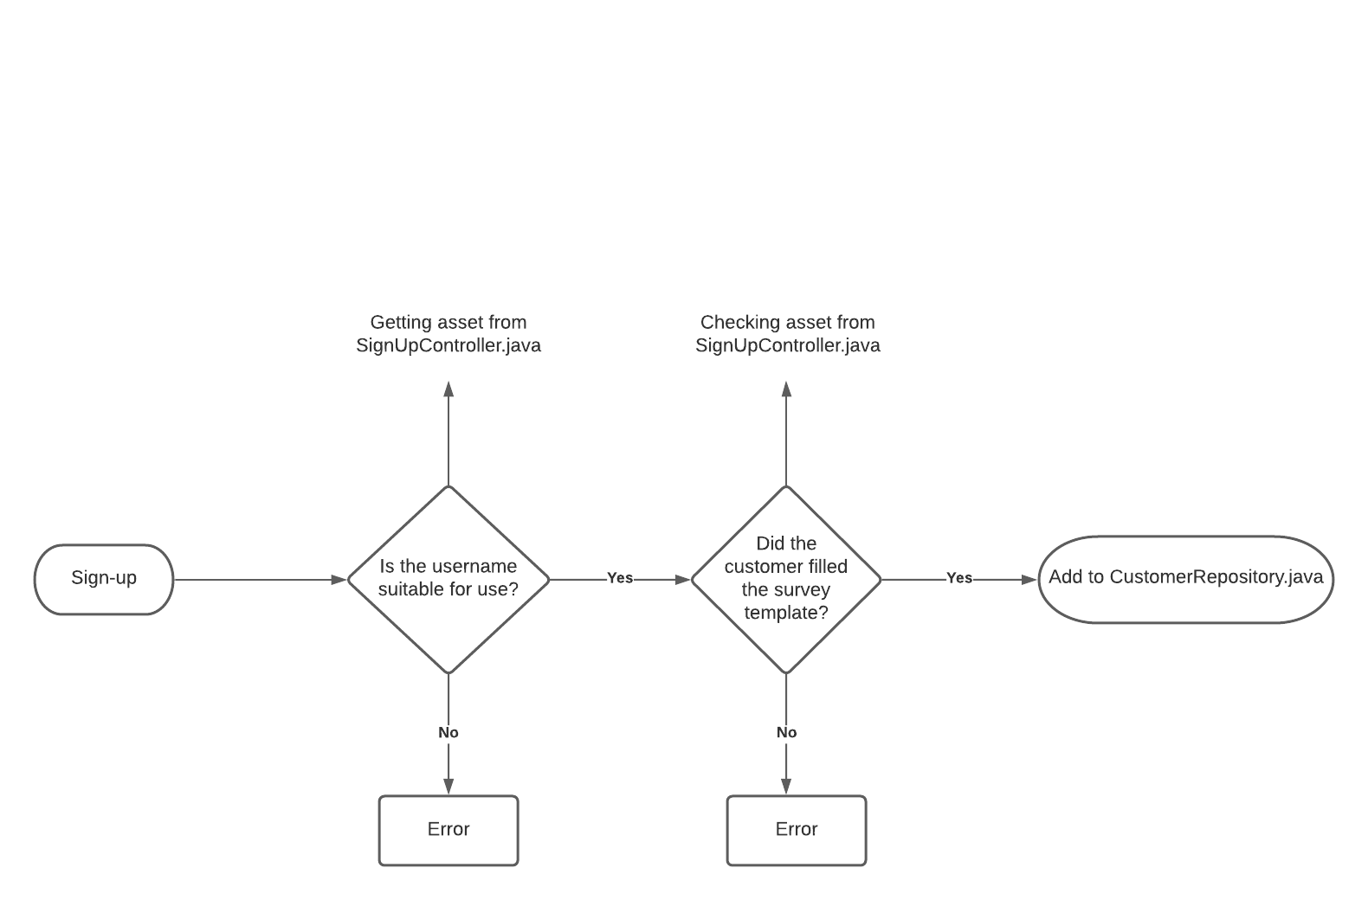
External Perspective of Sign-up Process
Sign-up Process
Getting asset from SignUpController.java
Checking asset from SignUpController.java comparing to database

